Slide 1
What are Long Running jobs and how to Monitor them

Slide 2

Long running jobs are the jobs which are running more than the given threshold time or limit.
As mentioned, jobs that exceed certain time frame are referred as long running jobs. In our case, we consider any application that is running more than 12 hours as a long running application.

Slide 3
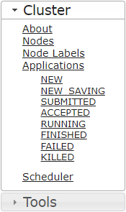
Process to Monitor Long running jobs:
Step 1:
Open any YARN URL
Step 2:
Once after opening YARN URL, we will be able to find 2 dropdown menu's on the left side names as Cluster and Tools. As shown in left-side picture

Slide 4
Step 3:
As we can see in the above picture under Applications we can find various states of a Job, you can choose any of the state based on your priority and actual application status
Step 4:
We can also click on the Scheduler button which displays all the applications irrelevant of the state it is in.

Slide 5
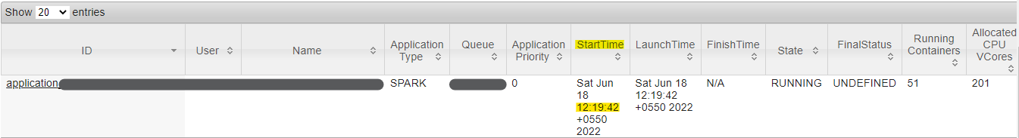
Step 5:
Select any application of your choice. In this article, I will be clicking on Scheduler and choosing my application.
As we can see from the above picture, once I clicked on Scheduler I received few applications and I choose the above application.

Slide 6
Also, we can see the Start time, which is the start time of that particular application. And the time it is displaying is IST time.
We can calculate an application whether it is long running or not, by checking with start time and comparing it with current time. By this we can know how long an application is running.

Slide 7
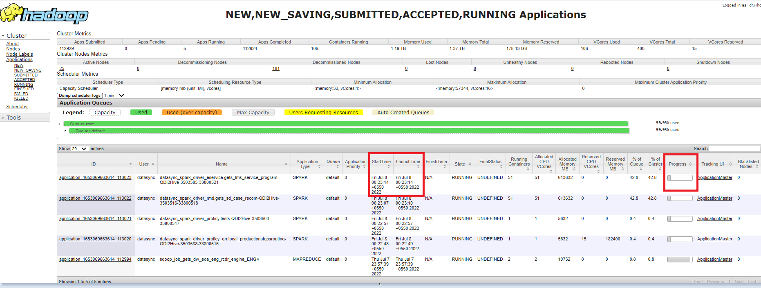
We can monitor each job progress in Yarn.

Slide 8
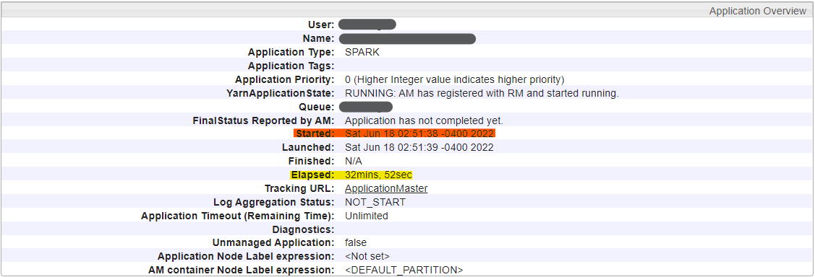
There is also another process explained in next step
Step 6:
In the 5th step, the first column of the picture which says ID will be having a application ID and it is a clickable link. By clicking on it, we can get more information regarding that particular application.

Slide 9
Once after clicking on the application ID, the above page will be opening, which gives an application overview.
In the above picture, Elapsed is the time, which calculates how long the application is running. As we can see this particular application is running for 32mins.
Also, started here highlighted in orange color displays the time in EST hours. This is different from previous step (5th step), in which it shows start time in IST hours.
By following the Step 5 and Step 6, we can able to get information on how long a application is running.

Slide 10
YARN URL'S: Ingestion Cluster: http://emr-ing.corp.wabtec.com:8088/cluster/ Jobdef Cluster: http://emr-jobdef.corp.wabtec.com:8088/cluster Con-int Cluster: http://emr-con.corp.wabtec.com:8088/cluster ES Cluster: http://10.91.41.111:8088/cluster/scheduler

Slide 11
If job exceeds, then will send an information to respective DL's to take further step. Based on reply, we will kill the job or make it run accordingly
Thank You

